Slide 1
Mini-project-I
Calgary, 2021-March-04

Slide 2
Introduction
About presenter
The motivation – Task in Hand
Dataset
Tools
Analysis flow and Results
Issues

Slide 3

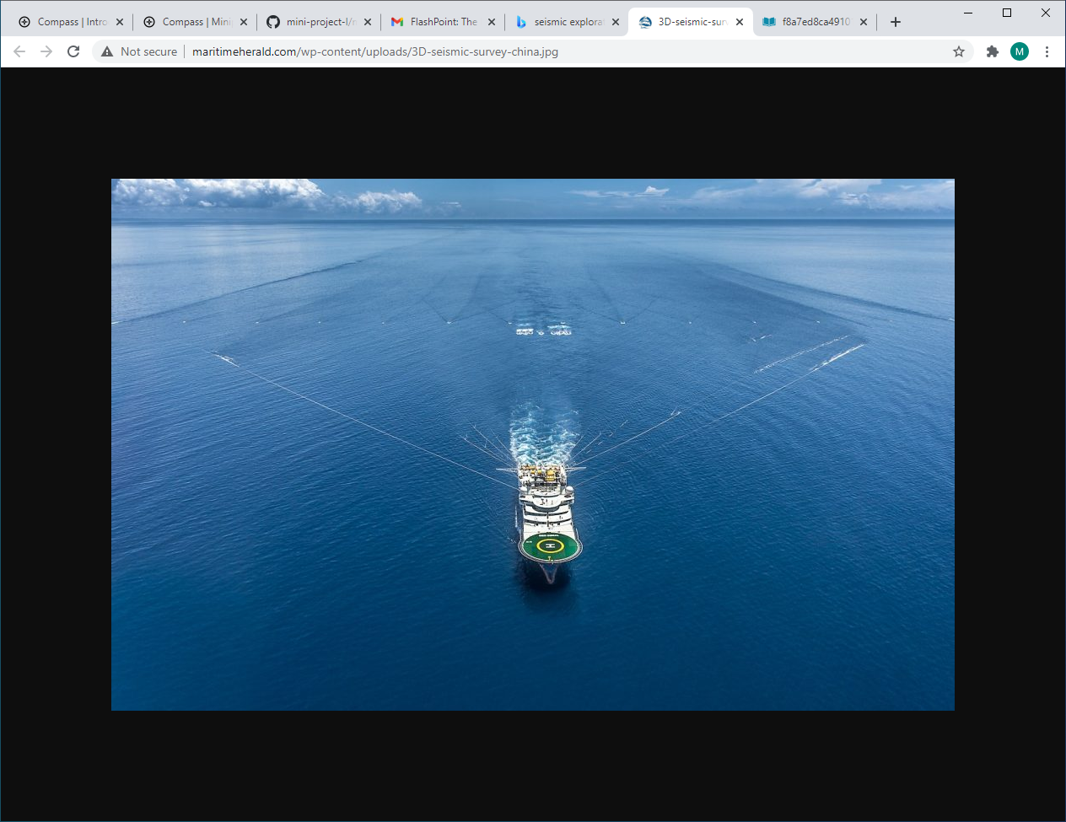
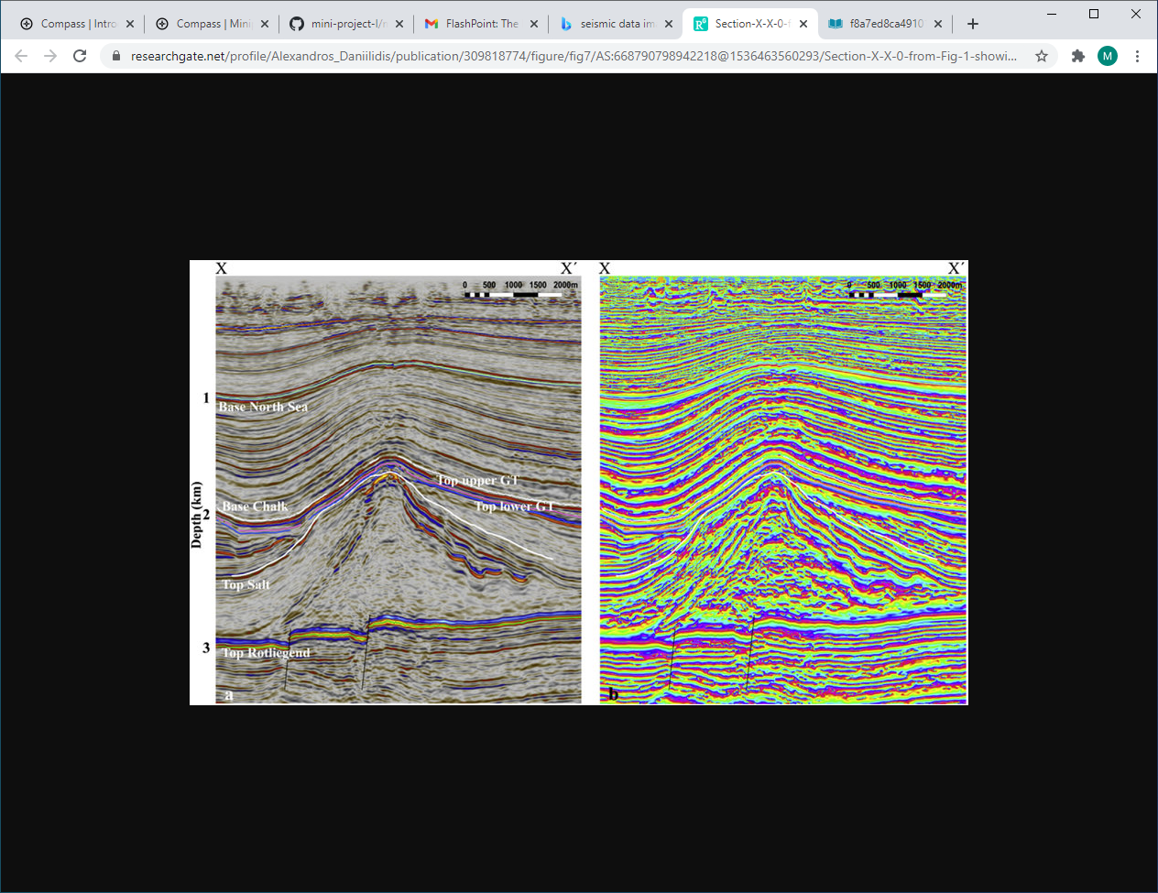
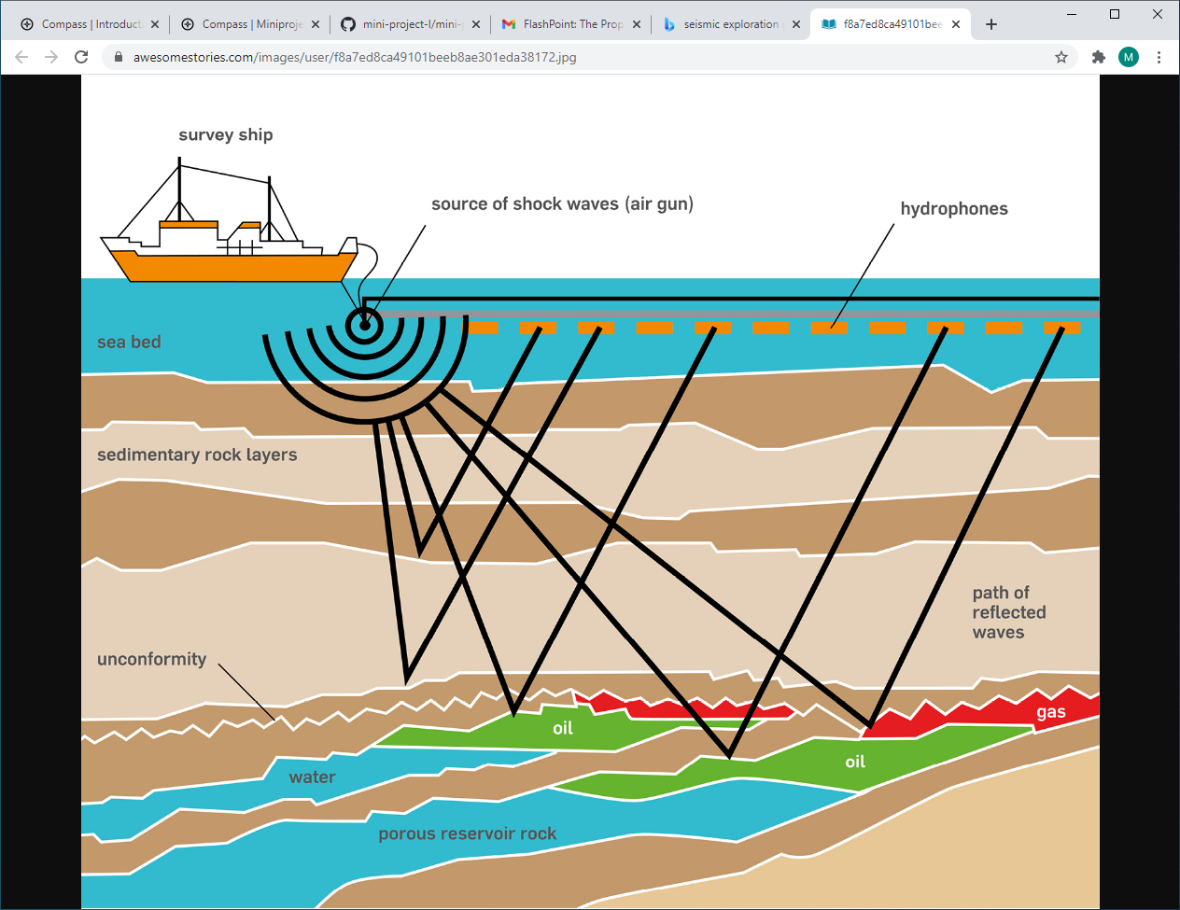
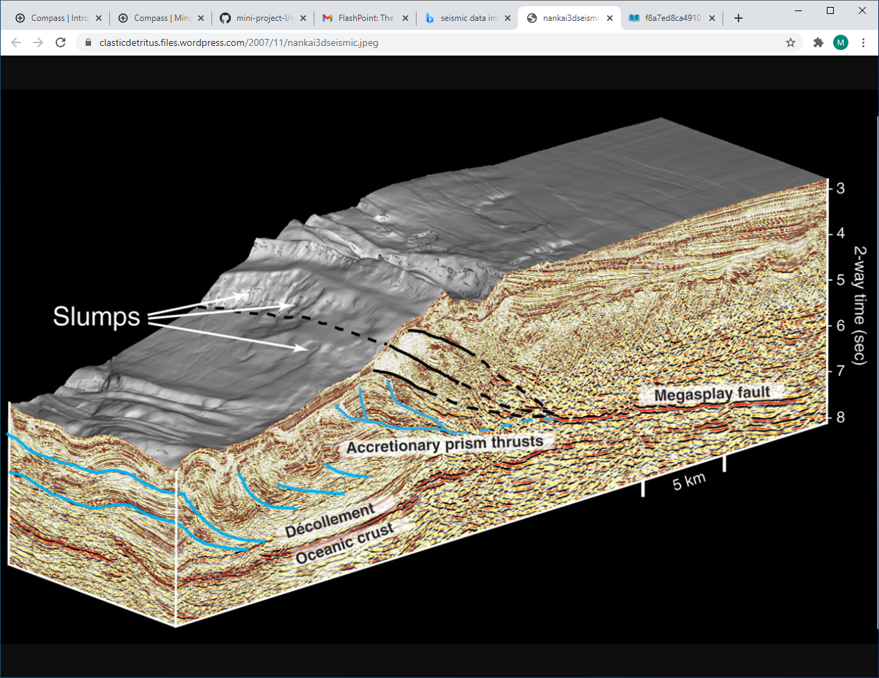
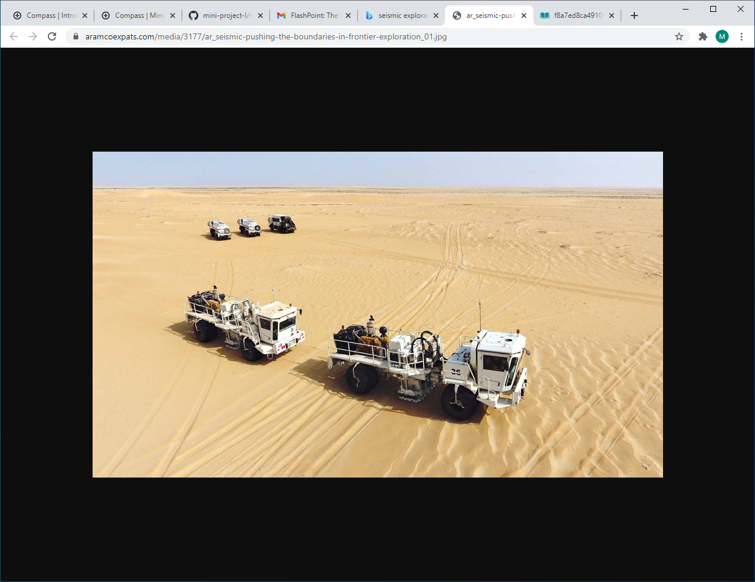
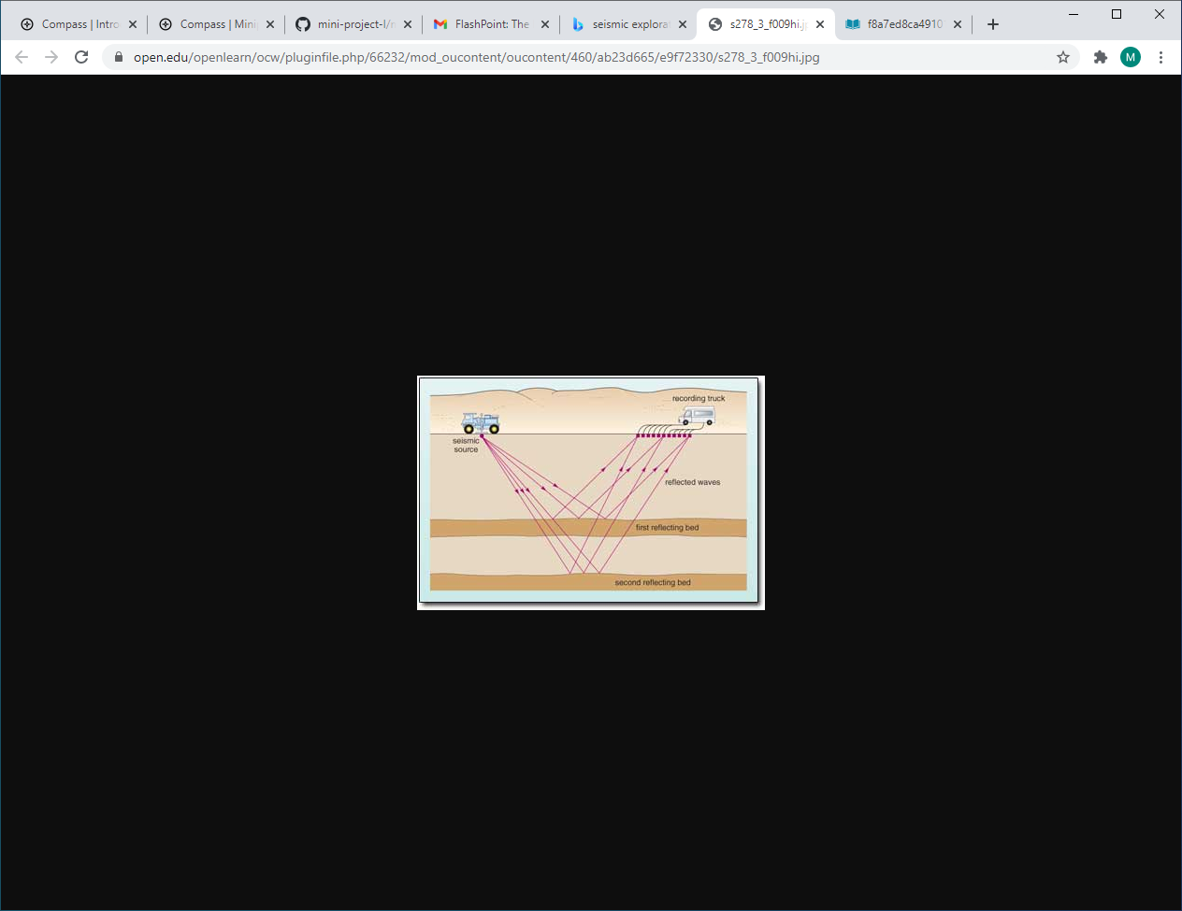
Presenter - Background
Bachelor degree in Geophysics from Gubkin University – Moscow
Seismic Exploration – Acquisition & Processing
Data Acquisition
Data Processing & Interpretation

Slide 4
The Motivation – Task in Hand
APIs in Python
HTTP requests
Python Packages.
Dealing with environmental variables.
Getting and reviewing the gathered data.
Dealing with nested structures while extracting info from the data.
Learning while doing mistakes.
The main goal of this project is to practice different HTTP requests and extracting values from complex lists and nested dictionaries

Slide 5
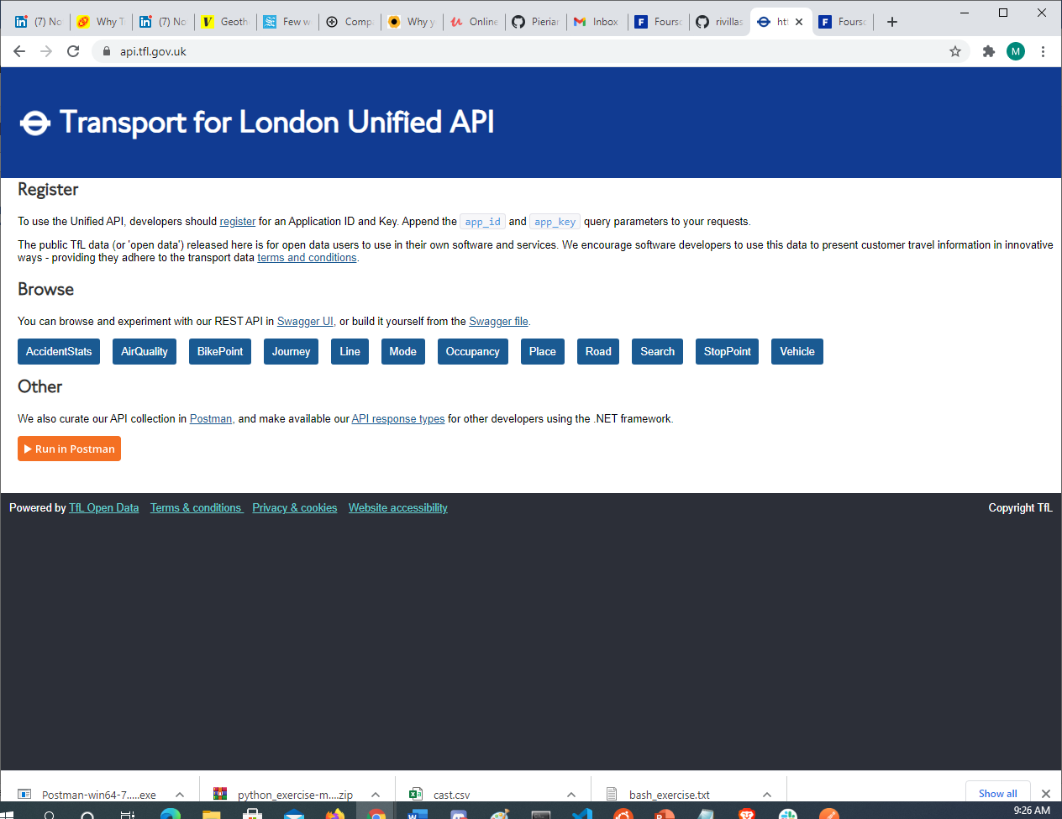
Dataset
Gets air quality data feed [Weather Forecast]
Gets the list of available StopPoint additional information categories [Modes of Transport: Bus, tube, etc..]
Gets all bike point locations [Locations, number of Docks and status: empty; number of bikes]
Gets a list of valid services, routes, lines, stations per line, modes [tubes, bus, etc..], etc
Gets a list of all of the available journey planner modes and allows performing a Journey planner search.

Slide 6


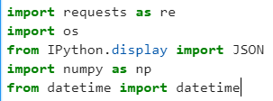

Tools
-Data Load
-API request
-Display
-Fetch

Slide 7
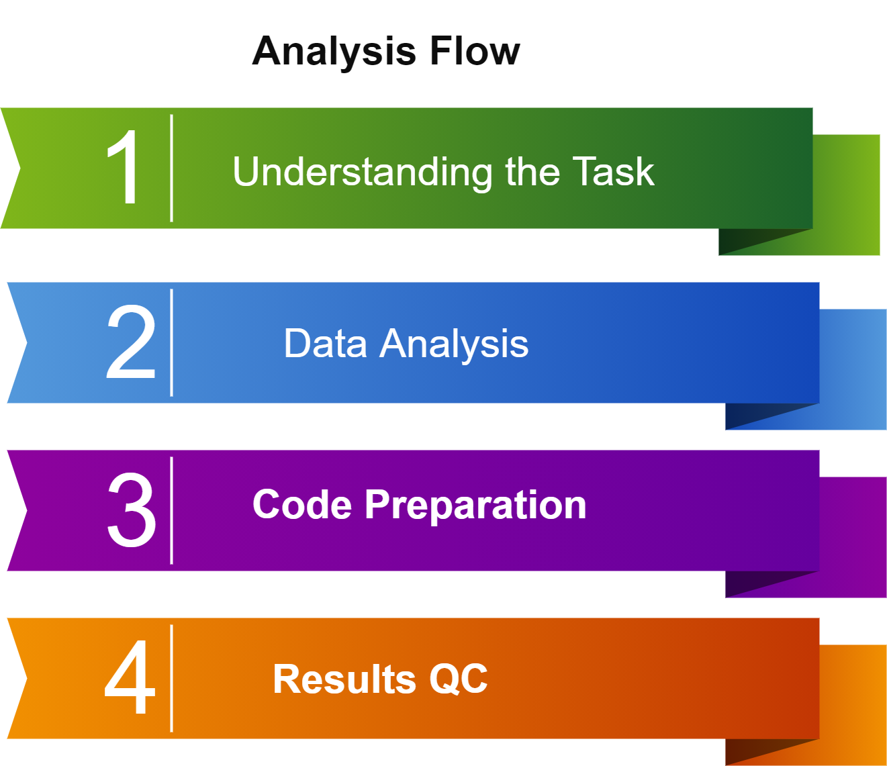
Analysis flow and Results
Environment Variables set up
Import of libraries
Requests/os/JSON
Create the URL
Request the data
QC Requests status &
Display results JSON
Extract the info from the data

Slide 8
Results - AirQuality predictions for tomorrow
AirQuality
url = "https://api.tfl.gov.uk/AirQuality/ [currentForecast/forecastText]"
Friday forecast to be dry with periods of sunshine and continued northern air feed.
Dry with sunny spells on Saturday
The expected northerly air flow should ensure a clean air feed and good dispersion of any locally produced pollutants.
Air Pollution is expected to remain Low for the following pollutants:
Nitrogen Dioxide;
Ozone;
PM10 Particulate;
PM2.5 Particulate;
Sulphur Dioxide']

Slide 9
Results – Modes of Transport
ShotPoint
url = "https://api.tfl.gov.uk/StopPoint/Meta/Modes [modeName]"
Seq | Transport Mode
1 | Bus
2 | Cable-Car
3 | Coach
4 | Cycle
5 | Cycle-Hire
6 | Dlr
7 | Interchange-keep-sitting
8 | Interchange-secure
9 | National-rail
Seq | Transport Mode
10 | overground
11 | Replacement-bus
12 | River-bus
13 | River-tour
14 | Taxi
15 | Tflrail
16 | Tram
17 | Tube
18 | walking

Slide 10
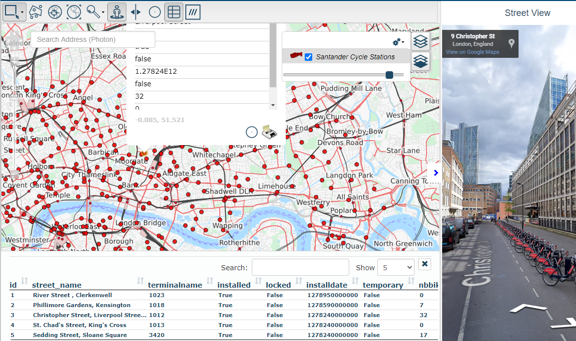
Results – BikePoints operated by TFL, total docks?
BikePoint
url = "https://api.tfl.gov.uk/BikePoint/ [additionalProperties][8][value]"
Around 792 BikePoints are operated by Transport For London.
With a total of 21,051 docks

Slide 11
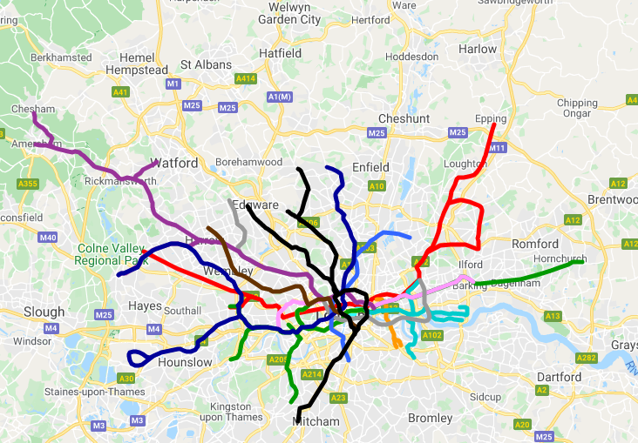
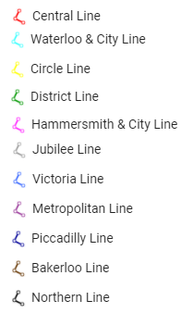
Results – How many tube and bus lines are in London?
Line
url = "https://api.tfl.gov.uk/Line/Mode/ [bus/tube]"
11 Tube Lines
679 Bus Lines

Slide 12
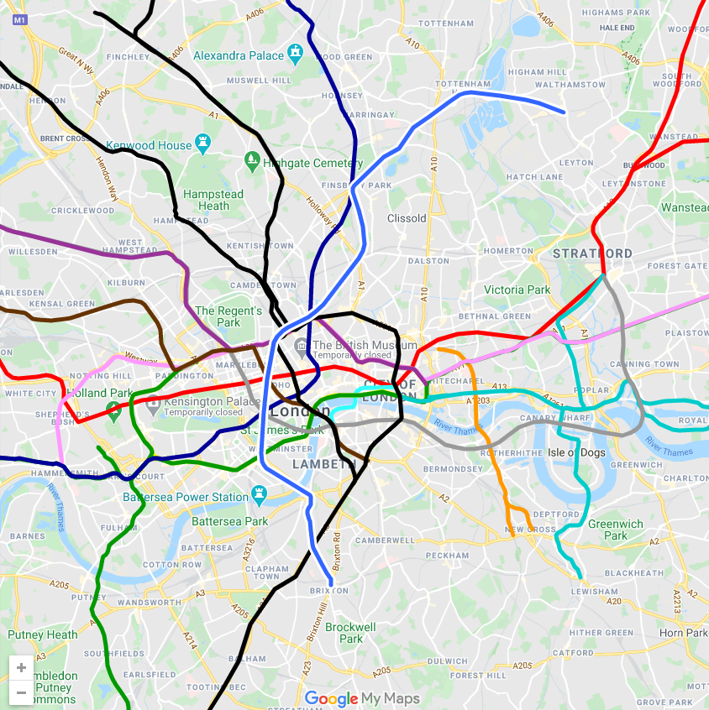
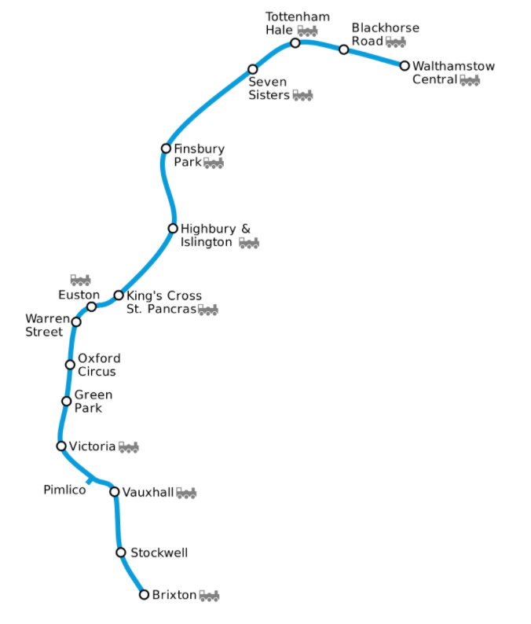
Results – How many tube and bus lines are in London?
Line
url = "https://api.tfl.gov.uk/Line/Victoria/StopPoints/"
11 Stations

Slide 13
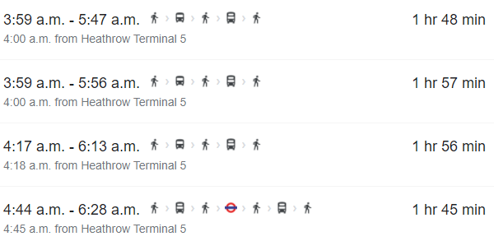
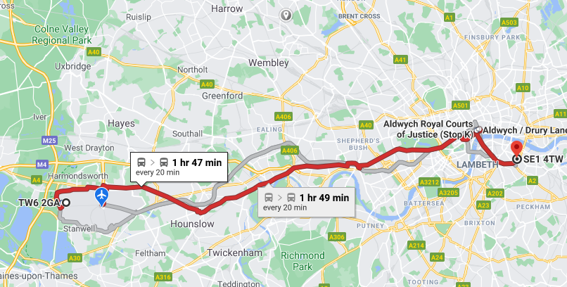
Results – Plan journey from Heathrow Airport to Tower Bridge?
Journey
#Airport_postcode=TW62GA; #Tower_post_code=SE14TW
url = "https://api.tfl.gov.uk/Journey/JourneyResults/TW62GA/to/SE14TW?mode=bus”
Google map
109 minutes by bus

Slide 14
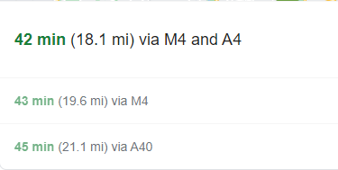
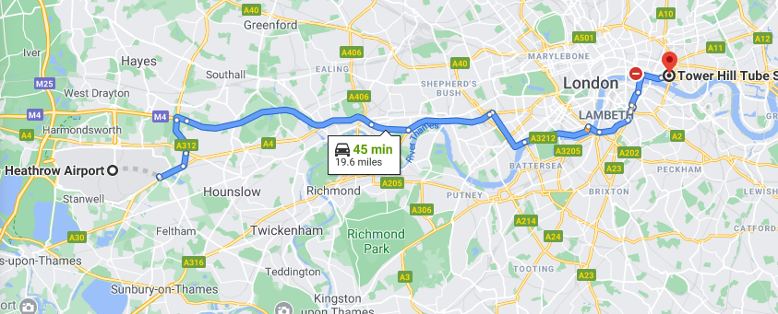
Results – Plan journey from Heathrow Airport to Tower Bridge?
Journey
#Airport_postcode=TW62GA; #Tower_post_code=SE14TW
url = "https://api.tfl.gov.uk/Journey/JourneyResults/TW62GA/to/SE14TW?mode=tube”
Google map
92 minutes by Tube

